Slide 1
TITLE: WORLDWIDE EDUCATION SYSTEM NAME:EDMOUND RAMOYA DATE: 21/12/2023

Slide 2
Today am excited to share Education system based on gender across the world.
I was concerned more so on enrollment rate and also equation balance when it comes to number of males and females in schools as they advance in their education in different countries and to be honest I discovered there is more numbers of male students compared to female in schools especially in Africa.

Slide 3
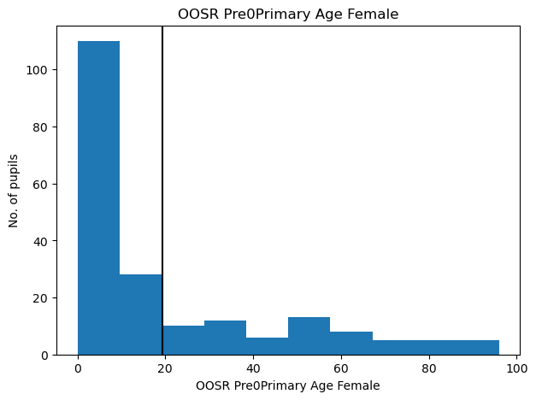
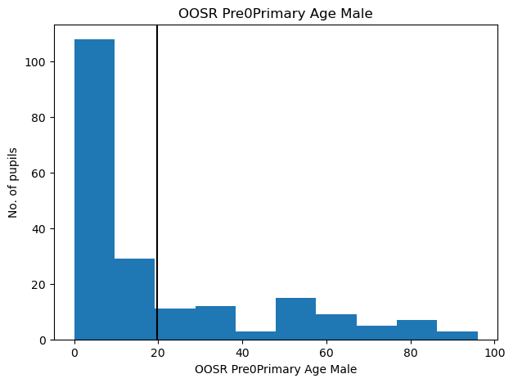
I was able to discover there is high rate of school drop out in most contries. And I have a record below,

Slide 4
Solution: In Africa, they should reduce unemployment rate and also try to help Girls with educating them on importance of education.

Slide 5
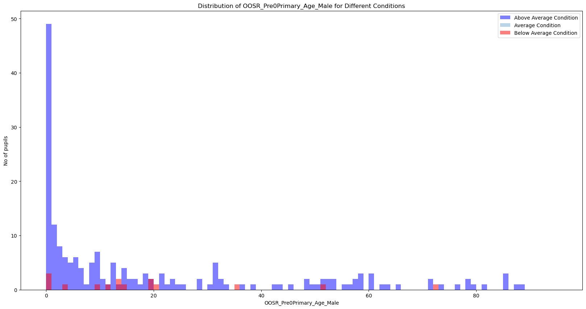
Methodology:
I conducted surveys from different Datasets, Group discussions and also from different Graphical presentations I had analyezed.
Eg.

Slide 6
Recommendations
To reduce school drop out numbers across, the government should reduce unemployment rate which can motivate students to school.
The government should stress so much on importance of education especially to ladies.
As much as there is high percentage of birth rate, the government should do a follow up of those children to make sure they get Education.

Slide 7
Discussion:
Implementing the above mentioned problem resolutions, I guess there will be low or no records of school drop out in most schools in different contries.

Slide 8
Conclusion:
In conclusion, the government should inform children on importance of Education and also create job opportunities this will motivate even students.

Slide 9
Future Work:
In future, I will explore financial status, economic challenges and Parents/Guardians responsibilities affecting children leading to their failure to join or discontinue with their education.

Slide 10
Q&A:
I would be happy to address any questions or concernes you may have.

